Slide 1
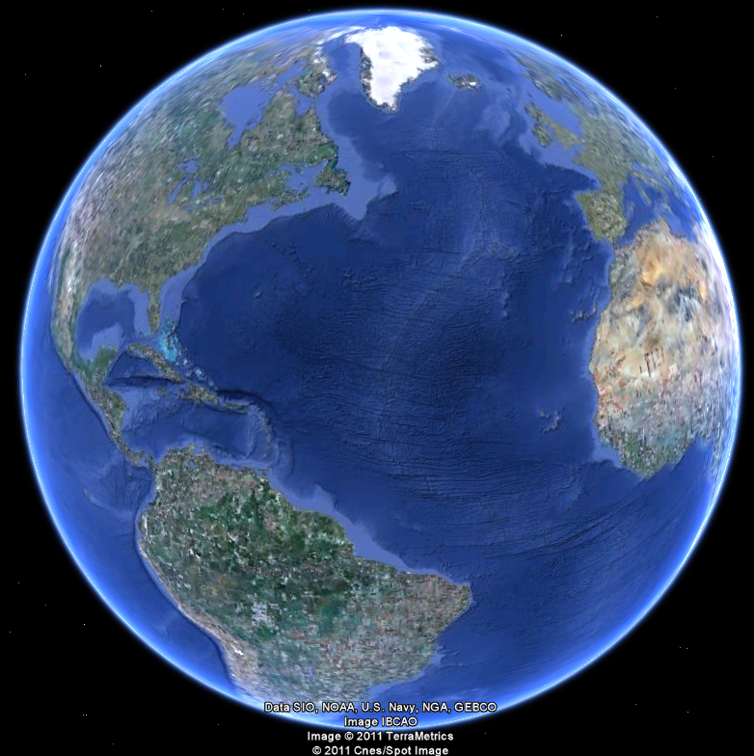
APEC 100 Sustainable Development
Cost Effective Conservation

Slide 2

Notes:
onthedemo.com

Slide 3
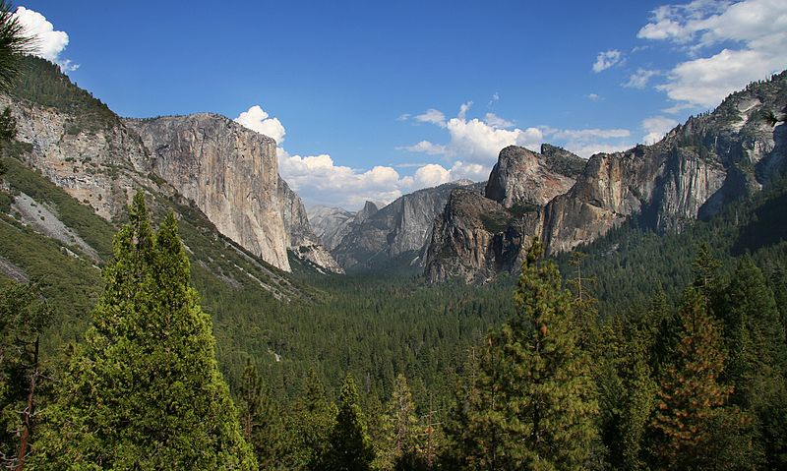
Yosemite, California 751,266 acres (1890) 1st National Park
59 National Parks in 27 states
51.9 million acres
More than 32 ‘Delawares’

Slide 4
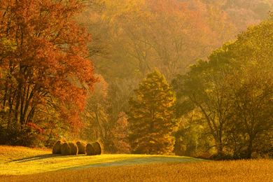
America’s Best Idea Expands National Wilderness areas (756 total, ~110 million acres) National Monuments (108 total) First State National Park, Delaware – 2014
Notes:
The Conservation Fund

Slide 5
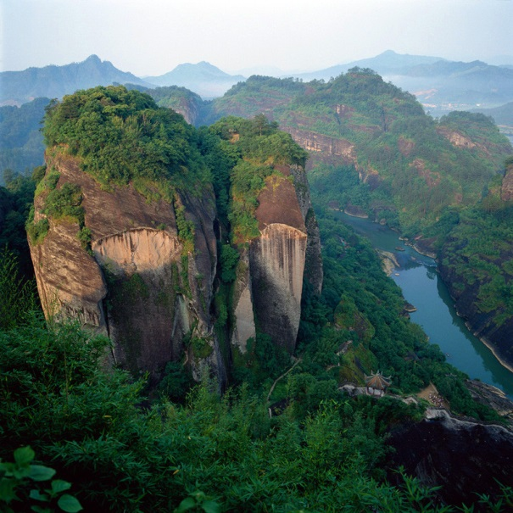
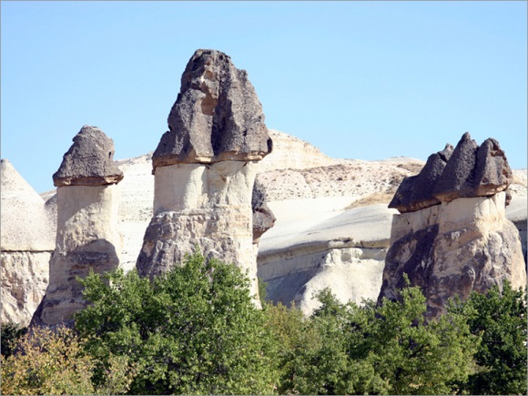
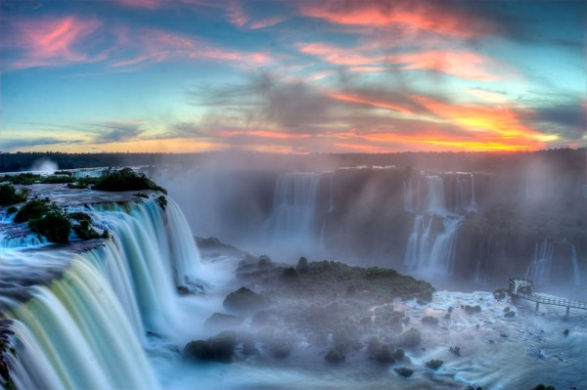
America’s Best Idea Expands UNESCO World Heritage Sites (981 worldwide)

Slide 6
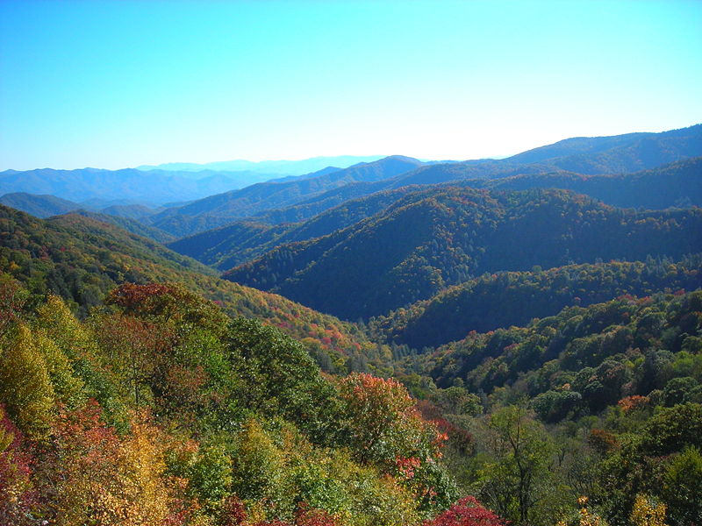
Great Smoky Mountains North Carolina, Tennessee – 521,490 acres (1934) Most visited – more than 9 million visitors annually

Slide 7
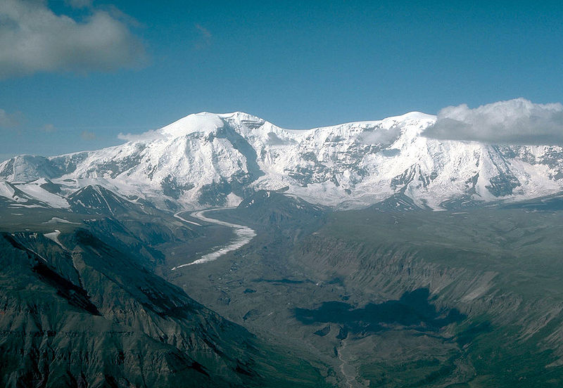
Wrangell-St. Elias, Alaska 8,323,148 acres (1980) Larger than 8 states

Slide 8
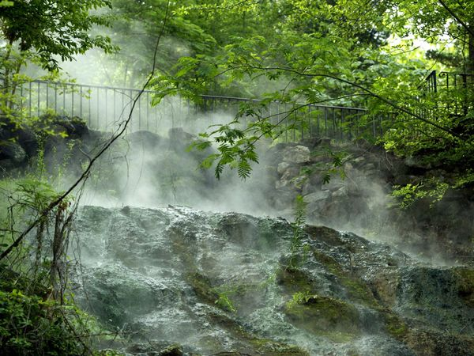
Hot Springs, Arkansas 5,550 acres (1921)

Slide 9
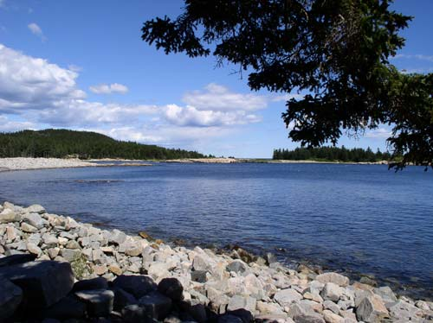
Acadia, Maine – 47,390 acres (1919)

Slide 10
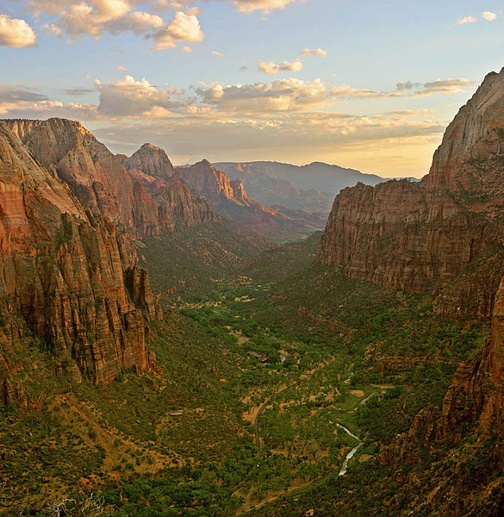
Zion, Utah – 146,598 acres (1919)

Slide 11
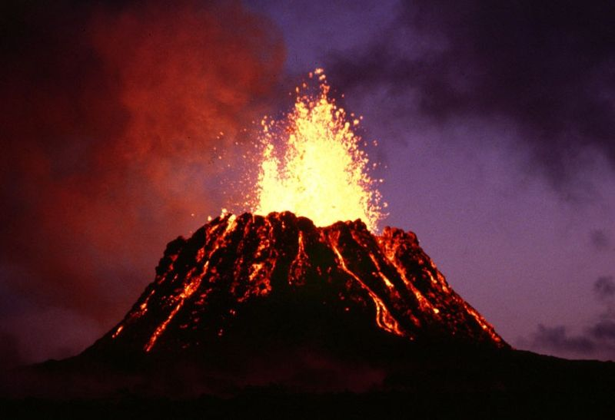
Hawaii Volcanoes, Hawaii 323,431 acres (1916)

Slide 12
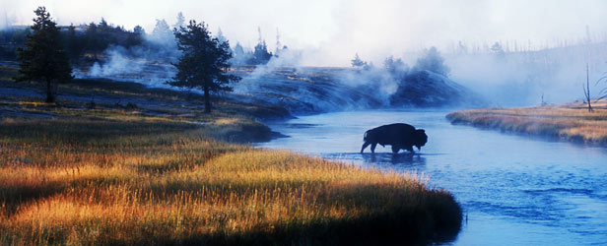
Yellowstone Wyoming, Montana, Idaho 2,219,791 acres (1872)

Slide 13
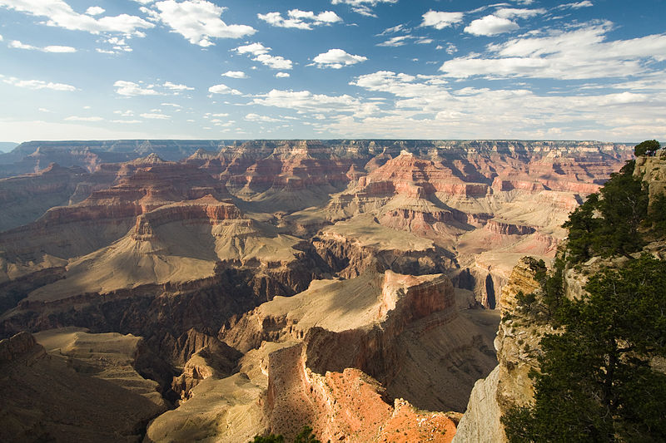
Grand Canyon, Arizona 1,217,403 acres (1919)

Slide 14
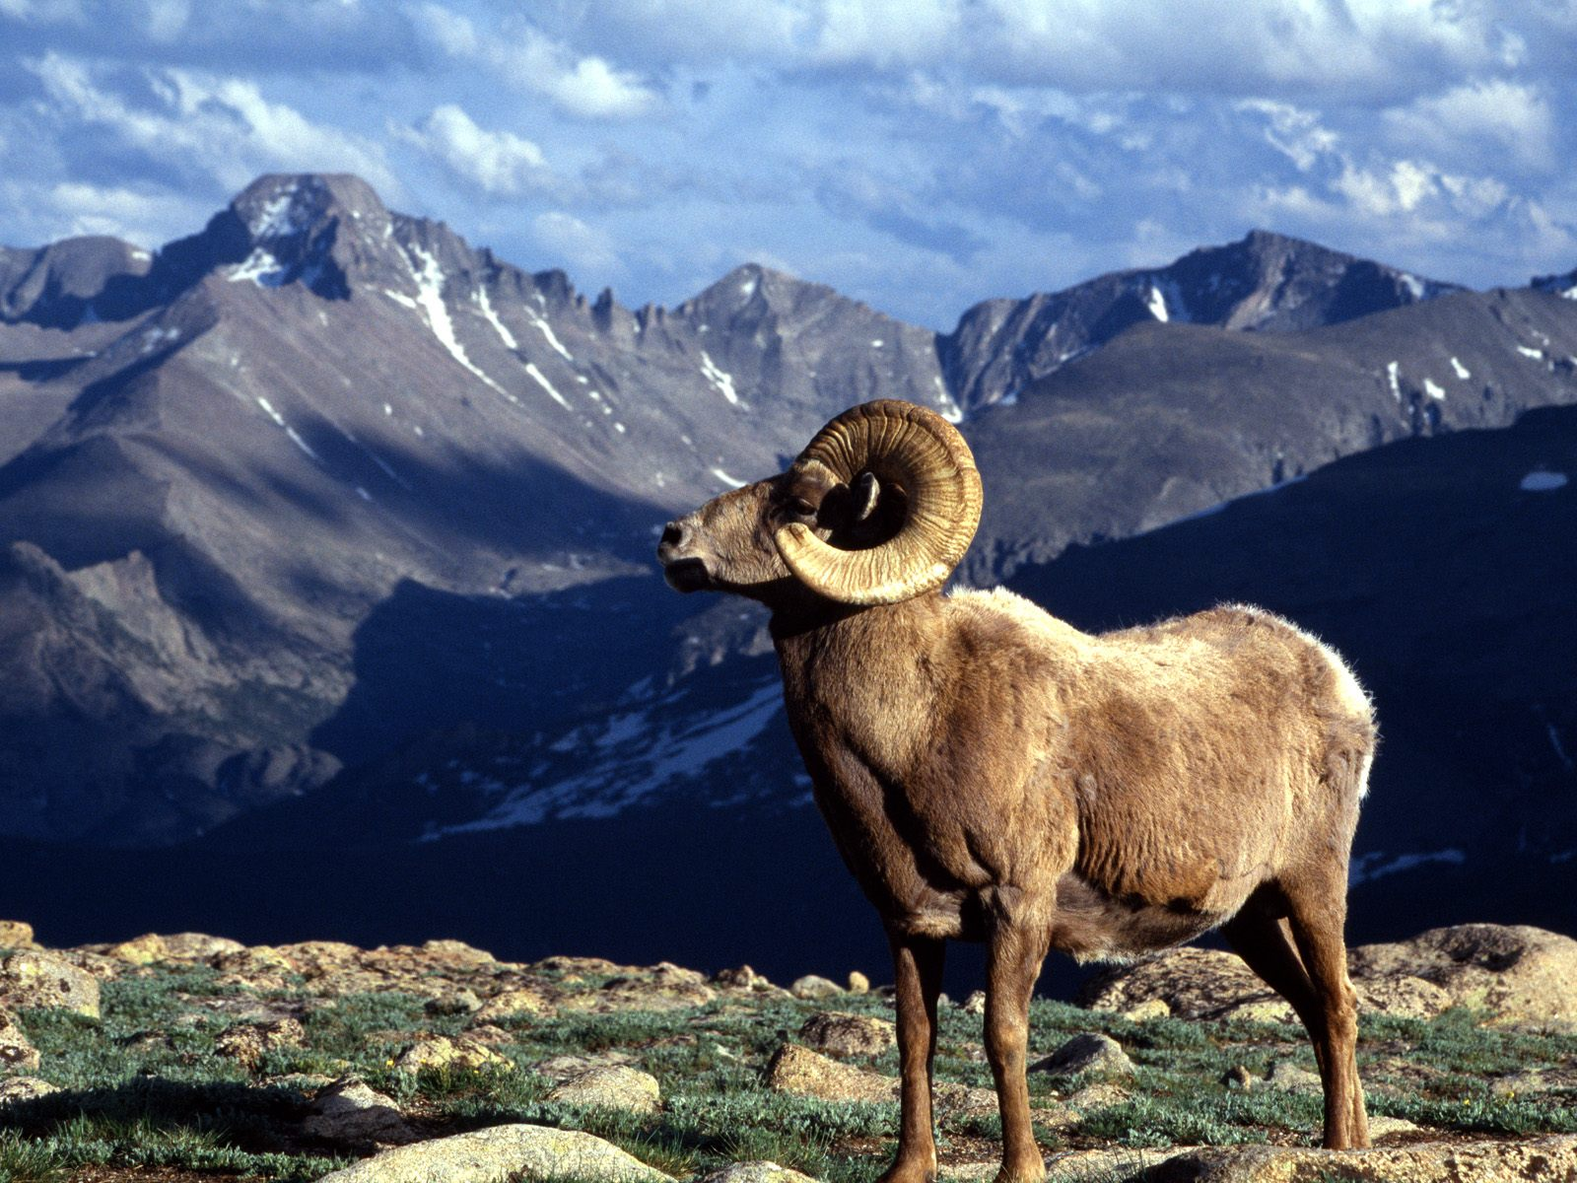
Rocky Mountain, Colorado 265,828 acres (1915)

Slide 15
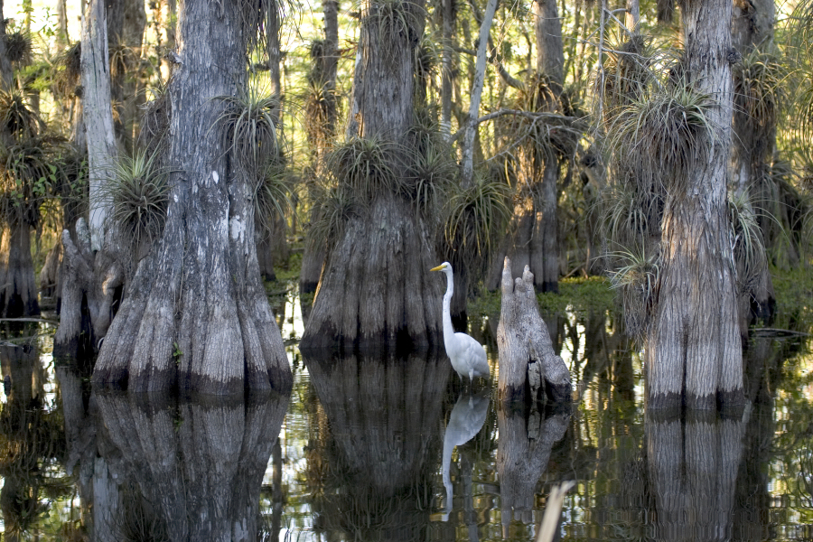
Everglades, Florida 1,508,538 acres (1934)

Slide 16
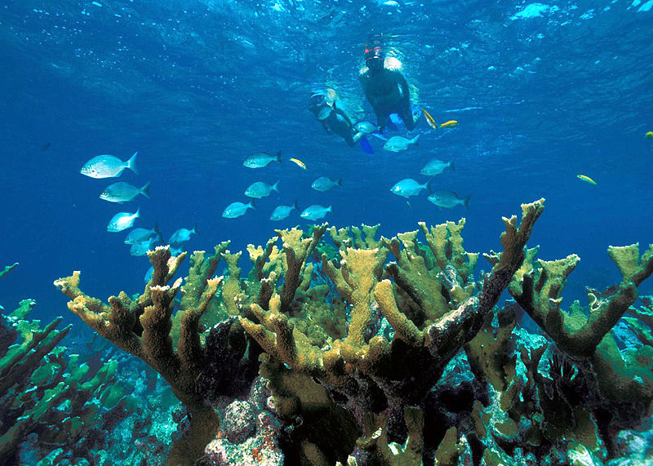
Biscayne, Florida 172,924 acres (1980)

Slide 17
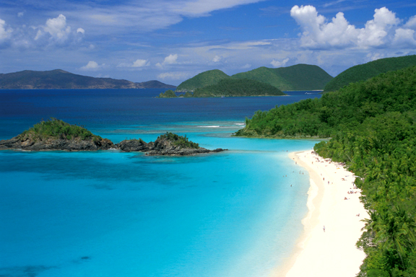
U.S. Virgin Islands 14,689 acres (1956)
Notes:
www.iaffdistrict12.org

Slide 18
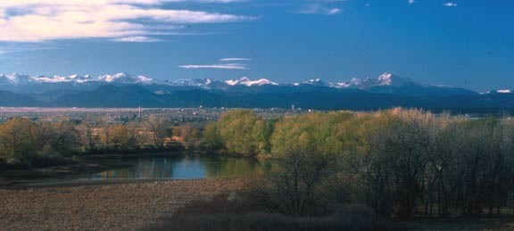
Heritage of America’s Best Idea
Inspiring Landscapes
Preservation of Magnificent Flora and Fauna
Promotion of a selection system that ignores opportunity costs.
Notes:
www.khammamrealty.com

Slide 19
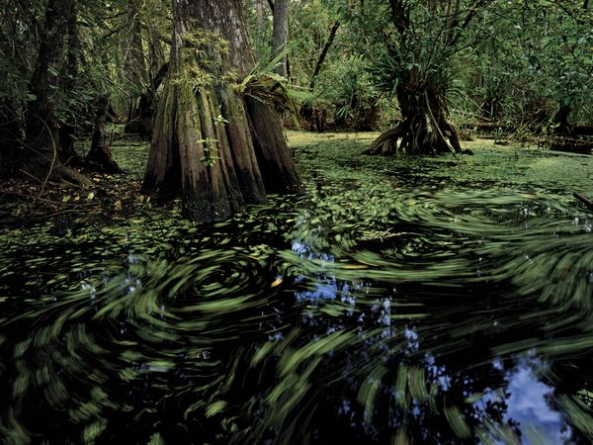
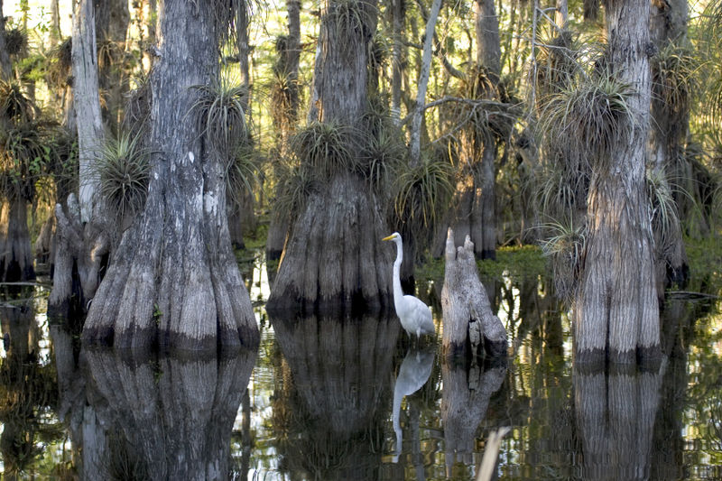
National Park Service - Federal Land Acquisition FY2012 National Priority List 34 projects, ~93,000 acres, ~$110 million (Thank you to Will Allen and The Conservation Fund for pointing out example)
Big Cypress National Preserve, Florida
(43,000 acres, $5,500,000)
Everglades, National Park, Florida
(477 acres, $25,000,000)
$52,370 per acre
Notes:
www.nationalgeographic.com
http://en.wikipedia.org/wiki/File:Everglades_National_Park_cypress.jpg

Slide 20
National Park Service Federal Land Acquisition FY2012 National Priority List
What projects could have been funded for that $25,000,000?
Big Cypress National Preserve, Florida
(43,000 acres, $5,500,000)
Notes:
www.nationalgeographic.com
http://en.wikipedia.org/wiki/File:Everglades_National_Park_cypress.jpg

Slide 21
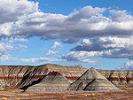
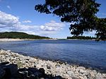
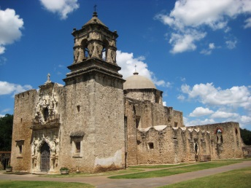
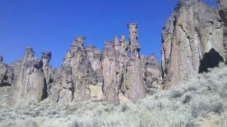
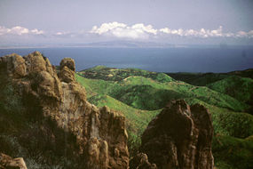
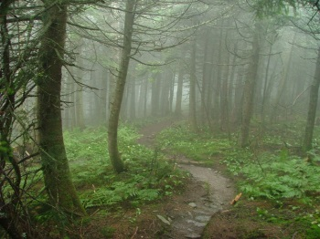
What projects could have been funded for that $25,000,000?
Name | Acres | Cost | Name | Acres | Cost
Petrified Forest, AZ | 26,496 | $5.5m | Acadia, ME | 37 | $3.0m
San Antonio Missions, TX | 20 | $1.2m | City of Rocks, ID | 878 | $2m
Santa Monica Mts, CA | 350 | $3.0m | Appalachian Trail, VT | 1,081 | $1.8m
Notes:
en.wikipedia.org;
www.hikercentral.com

Slide 22
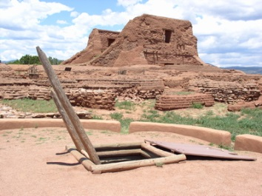
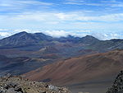
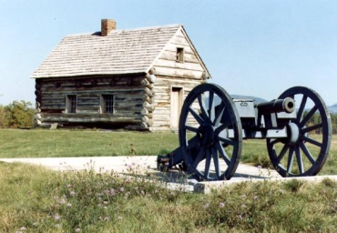
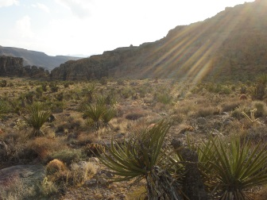
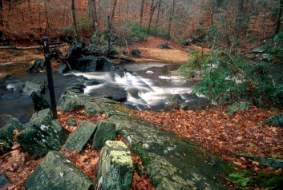
What projects could have been funded for that $25,000,000?
Name | Acres | Cost | Name | Acres | Cost
Pecos Ntl. Hist Park, NM | 9.2 | $0.8m | Haleakala, HI | 156 | $0.1m
Saratoga, NY | 350 | $3.0m | Mojave, CA | 200 | $0.4m
Prince William Forest, VA | 183 | $6.0m
Notes:
en.wikipedia.org;
graceamazing.wordpress.com

Slide 23
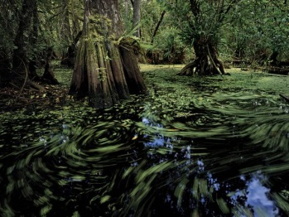
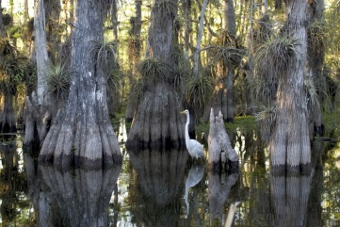

What is the best outcome for $30 million?
2 projects
43,477 acres
12 projects, 72,561 acres
(67% increase in acres)
Notes:
www.nationalgeographic.com
http://en.wikipedia.org/wiki/File:Everglades_National_Park_cypress.jpg

Slide 24
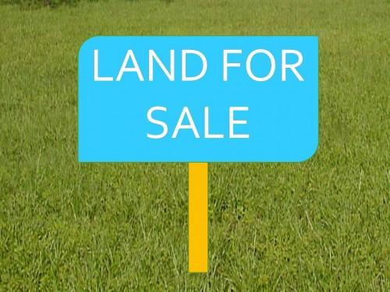
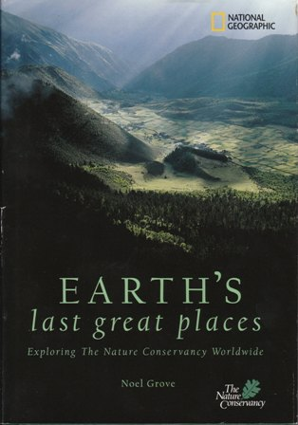
Is protecting the Last Great Places without considering cost always the best idea?
What if lots of money is wasted along the way?
Could this money be invested in other projects that better improve the environment?
Notes:
www.khammamrealty.com

Slide 25

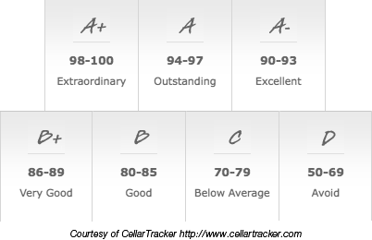
Is protecting the Last Great Places without considering cost always the best idea?
Budgeted $240 for wine for Thanksgiving and following weekend with friends and family.

Slide 26
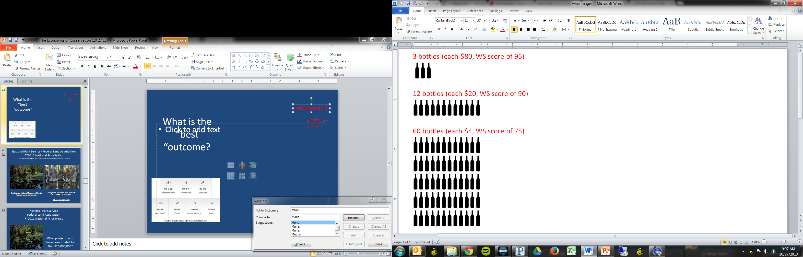
What is the best outcome for $240?
Benefit Targeting

Slide 27
What is the best outcome for $240?
Benefit Targeting
Optimization

Slide 28
What is the best outcome for $240?
Benefit Targeting
Benefit Targeting
Optimization
Optimization
Cost Targeting
Cost Targeting

